Slide 1
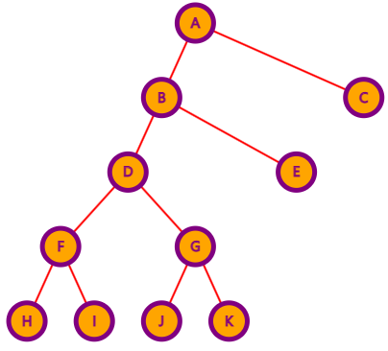
0
1
0
1
0
1
0
1
0
1

Slide 2
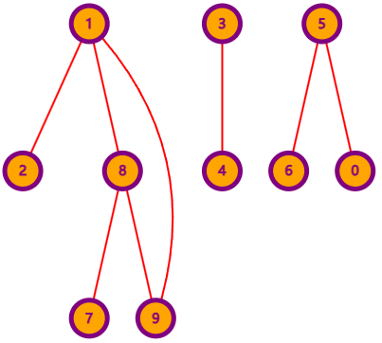

Slide 3
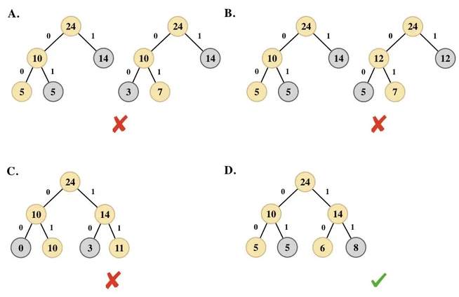

Slide 4
0100011001001011110101
a f e e f g d

Slide 5
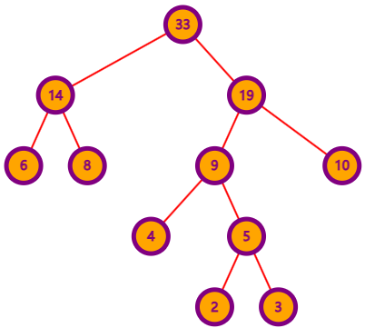
0
1
0
1
0
1
0
1
a
c
e
f
0
1
d
b

Slide 6
